Slide 1

Life Expectancy and GDP
[ 3.14 ]
Lucas Vianna
Felix Poley
Dan T Do

Slide 2

ourworldindata.org

Slide 3


Slide 4
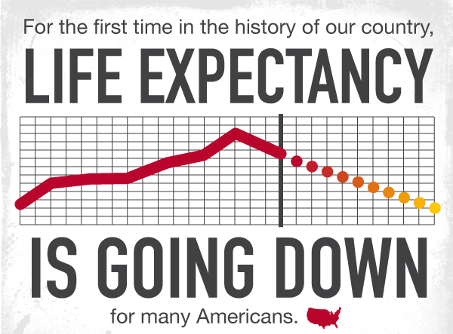

Slide 5
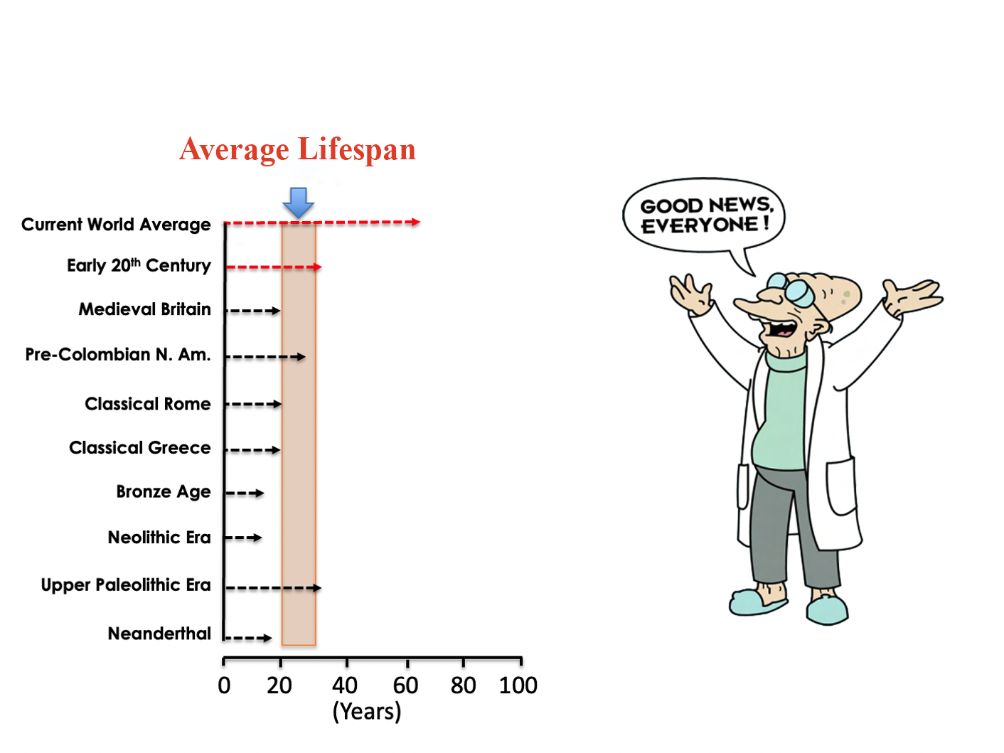

Slide 6

We are living far longer than our forebears …

Slide 7
United States of America

Slide 8
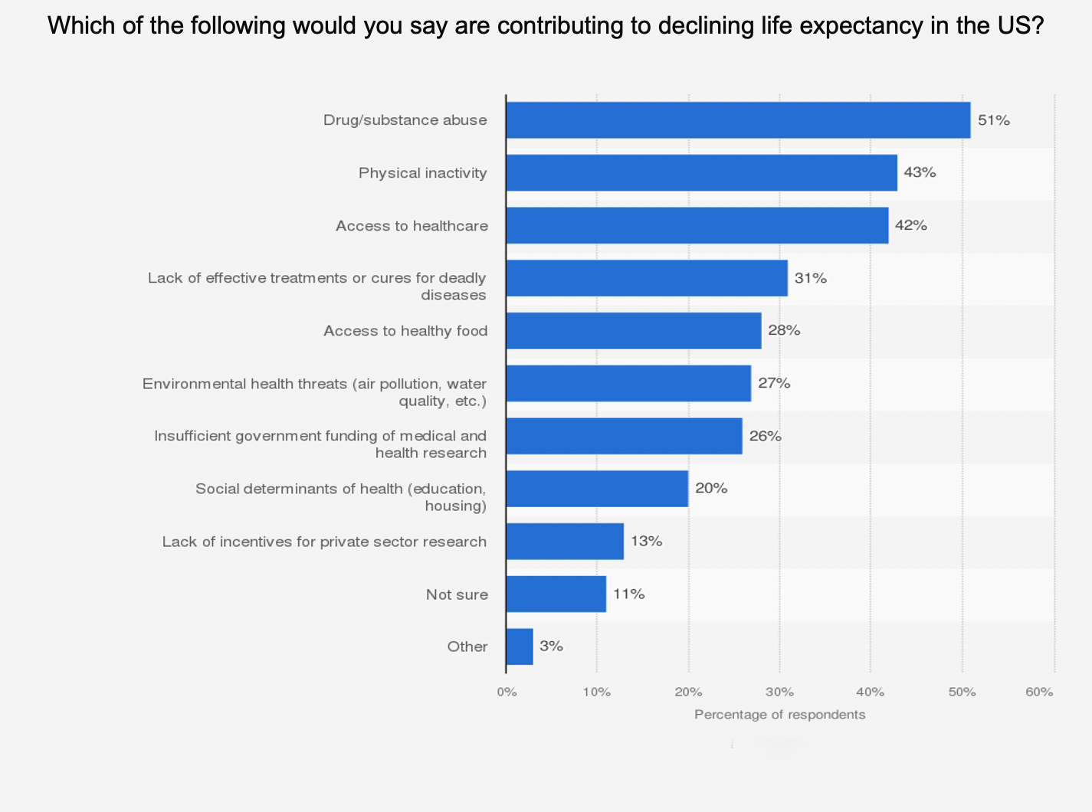

Slide 9


Do you know … ?
Medicine has extended our life expectancy.

Slide 10

What is Gross Domestic Product (GDP)?
GDP is the monetary value of all goods and services produced in a country in a year. It provides a snapshot of economic strength and growth rates.
The 5 countries with the largest GDP in 2020 were:
1. United States
2. China
3. Japan
4. Germany
5. United Kingdom

Slide 11

Inspiring Life Expectancy vs. GDP Data Visualizations

Slide 12
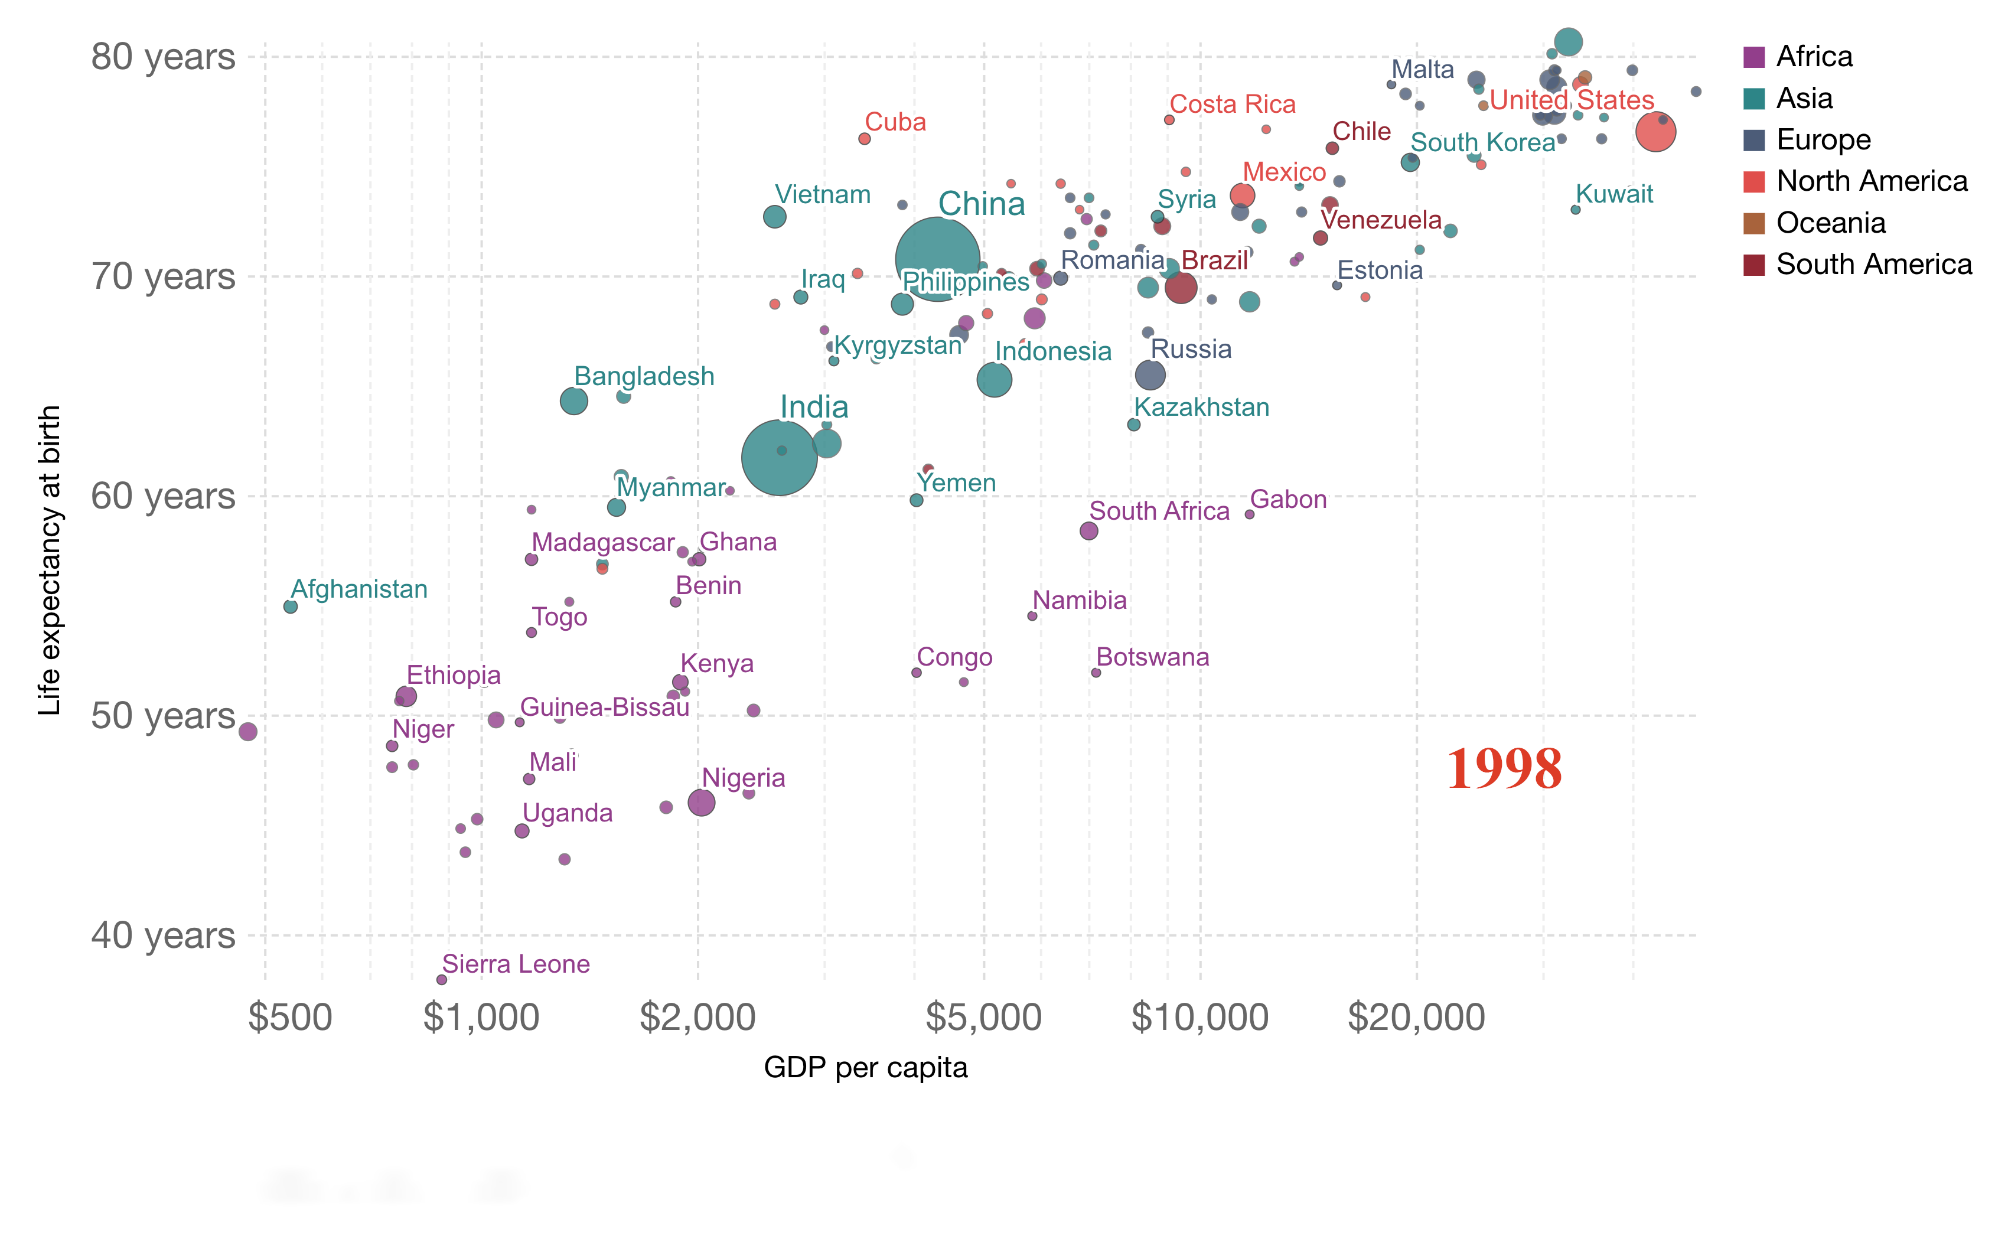

Slide 13
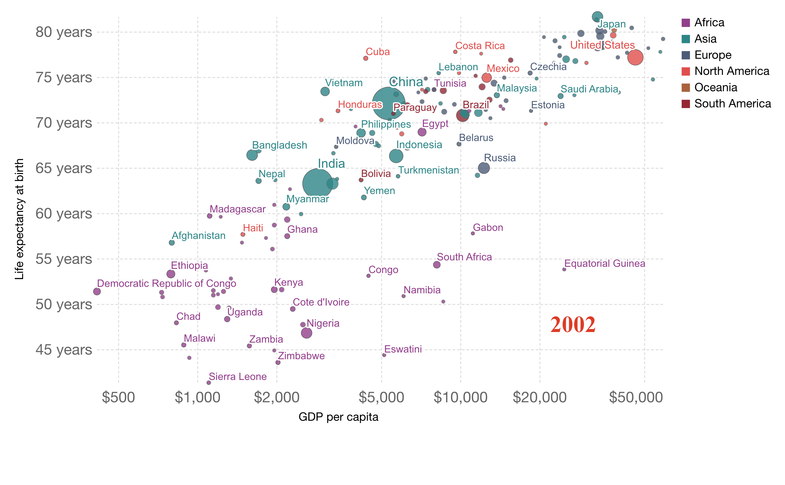

Slide 14
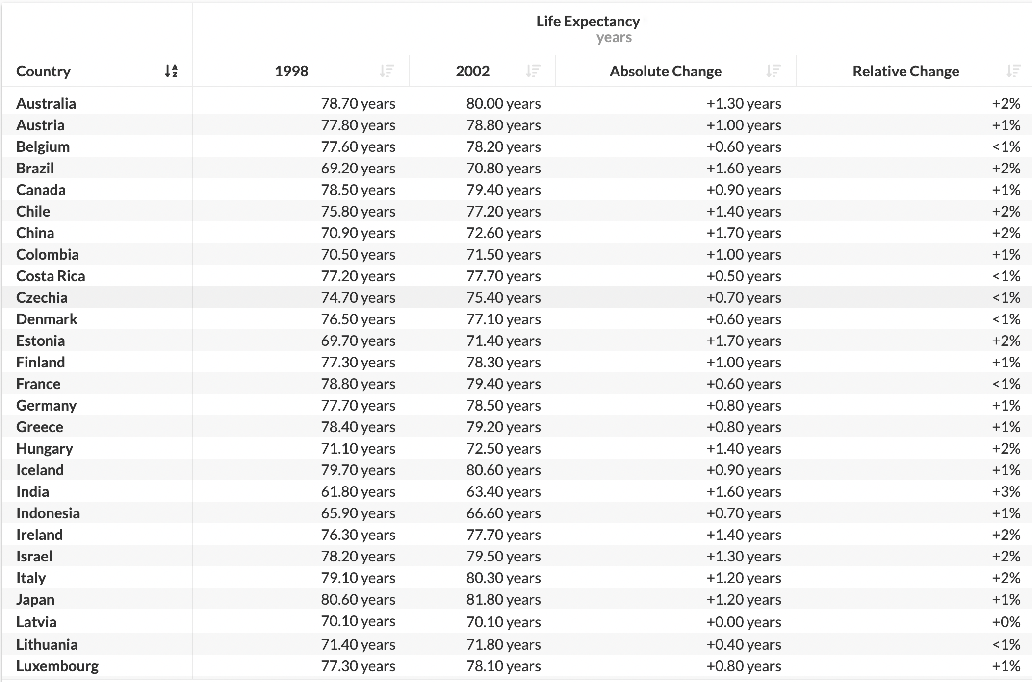

Slide 15
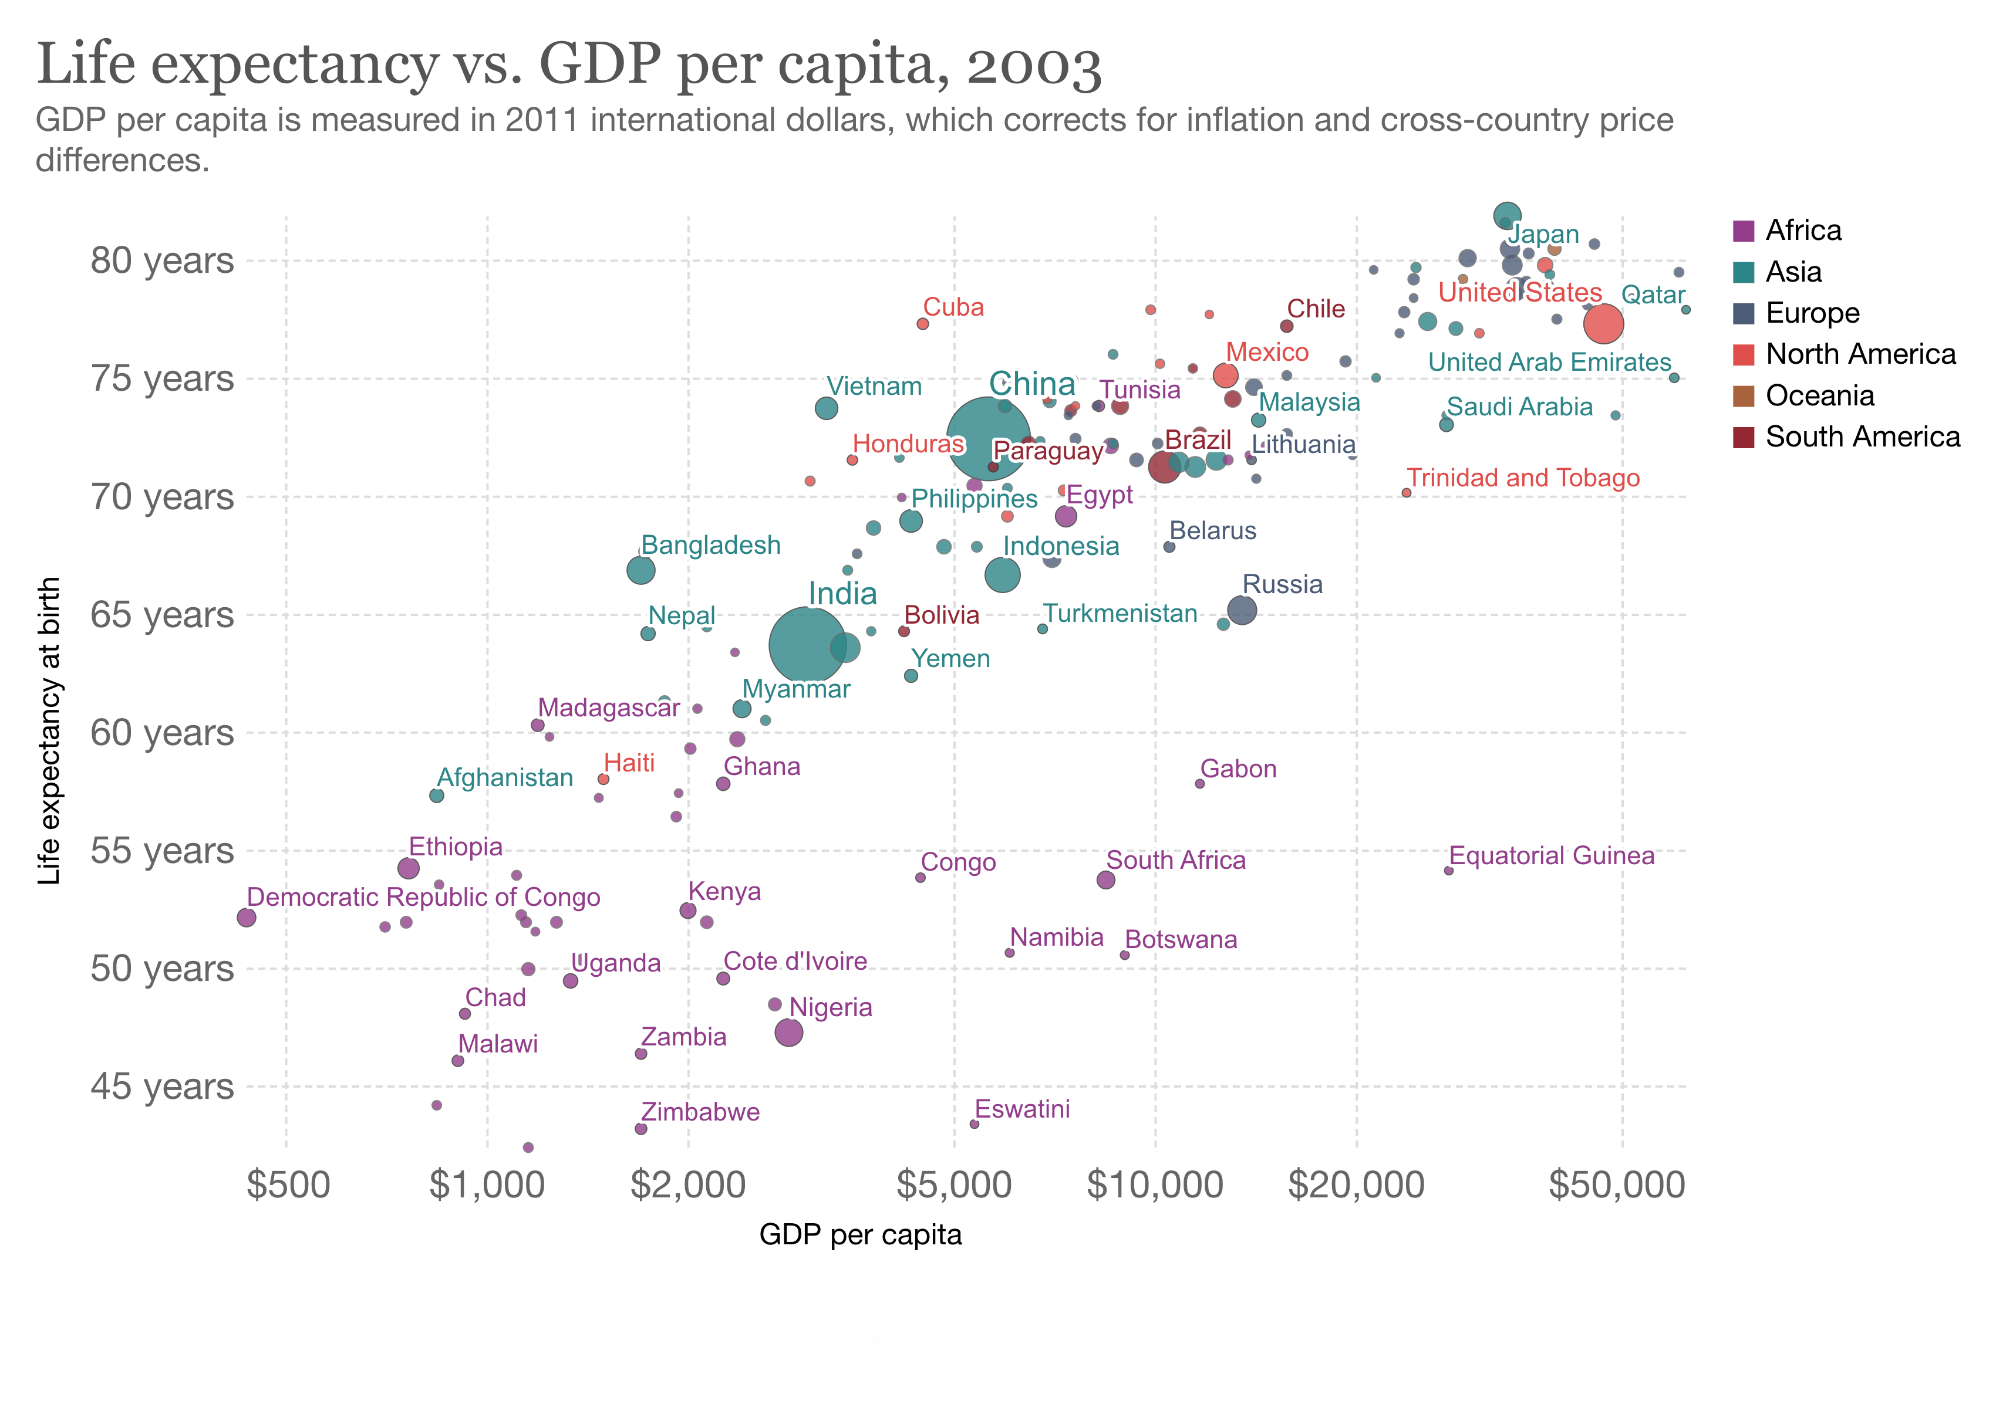

Slide 30
Conclusion

Slide 31
Thank You !

